Slide 1
Word Wall
a | b | c | d | e | f
g | h | i | j | k | l
m | n | o | p | q | r
s | t | u | v | w | x
y | z
Notes:
Clicking on the letter will take you to the corresponding page; click once on speaker button to hear the name of the letter being spoken.

Slide 2
a | Insert vocab word here | Insert graphic here | Type sentence with vocabulary word in it here.
 |  |  | Student’s turn to type a sentence:
 | ask |  | I need to ask a question.

Slide 3
b

Slide 4
c | camera |  | I took pictures with my camera.

Slide 5
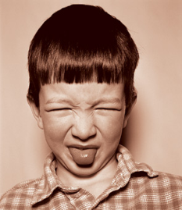
d | disgusted |  | That smell disgusted me.

Slide 6
e

Slide 7
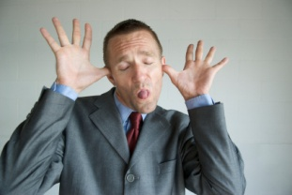
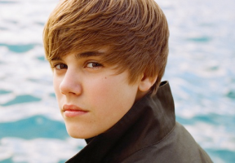
f | face |  | That’s a silly face.
 | famous |  | Have you met anyone famous?

Slide 8
g

Slide 9
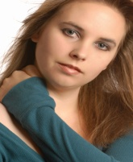
h | her |  | Her neck is sore.

Slide 10
i

Slide 11
j

Slide 12
k

Slide 13
l | list |  | Did you put milk on the grocery list?

Slide 14
m

Slide 15
n

Slide 16
o

Slide 17
p

Slide 18
q

Slide 19
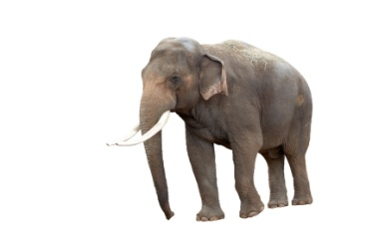
r | really |  | The elephant is really big.

Slide 20
s | smile |  | I like to smile.

Slide 21
t

Slide 22
u

Slide 23
v

Slide 24
w

Slide 25
x

Slide 26
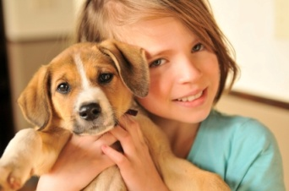
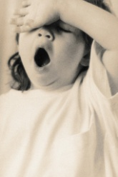
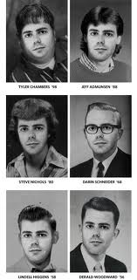
y | your |  | Your pet is cute!
 | you’re |  | You’re sleepy.
 | yearbook |  | Will you sign my yearbook?

Slide 27
z

Slide 28
a

